Slide 1

NLP Deep Dive
AI learning how to read like humans

Slide 2
What is NLP?
From previous lessons, you might have learned that NLP is AI that is trained to understand natural language
NLP will allow the AI to break down human text into something the AI can understand

Slide 3
NLP Processing
Text Preprocessing
Feature Engineering
Text Classification

Slide 4
Text Preprocessing
Tokenization
Noise Removal
Lexicon Normalization
Stemming
Lemmatization

Slide 5
Tokenization
Input | Output
Sentence Tokenization:
This Agreement will be governed and construed in accordance with the laws of the State of California without giving effect to conflict of laws principles. Both parties submit to personal jurisdiction in California and further agree that any cause of action arising under this Agreement shall be brought in a court in Orange County, California.
“This Agreement will be governed and construed in accordance with the laws of the State of California without giving effect to conflict of laws principles.” “Both parties submit to personal jurisdiction in California and further agree that any cause of action arising under this Agreement shall be brought in a court in Orange County, California”
Sentence tokenization: Breaks down a paragraph into sentence
Word tokenization: Breaks down a sentence into words
Watch how this paragraph gets decomposed.
Word Tokenization:
“This Agreement will be governed and construed in accordance with the laws of the State of California without giving effect to conflict of laws principles.”,
“This”, “Agreement”, “will”, “be”, “governed”, “and”, “construed”, “in”, “accordance”, “with”, “the”, “State”, “of”, ”California”, “without”, “giving”, “effect”, “to”, “conflict”, “of”, “laws”, “principles”.

Slide 6
Noise Removal
Input | Output
Remove Stop Words
Words that have no meaning and only used for grammatical syntax
“The”, “a”, “an”, etc. You can choose your stop words list
Punctuation can also be removed.
Noise Removal
“This Agreement will be governed and construed in accordance with the laws of the State of California without giving effect to conflict of laws principles.” Highlighted words/punctuation were removed.
“This Agreement will be governed and construed in accordance with laws of State of California without giving effect to conflict of laws principles”

Slide 7
Lexicon Normalization
Stemming
Strip the suffixes such as ing, ly, es, s, etc from a word
It’s rule-based process.
Lemmatization
This process changes words to their base form
It makes use of vocabulary (dictionary importance of words) and morphological analysis (word structure and grammar relations)
Input | Output
Word Tokenization:
“This Agreement will be governed and construed in accordance with laws of State of California without giving effect to conflict of laws principles” (Highlighted words were lexically normalized)
“This Agreement will be govern and construe in accord with law of state of California without give effect to conflict of law principle”

Slide 8
Feature Engineering
Features need be generated to analyze the pro-processed data
Entity Extraction - Grouping words into predefined categories.
Syntactical Parsing - Analyzing words and conforming them to normal grammar.
Statistical Features - Keep track of how much words show up.

Slide 9
Entity Extraction
Input | Output
Entity Extraction
“This Agreement will be govern and construe in accord with law of state of California without give effect to conflict of law principle”
Item: Agreement Location: State of California
Entity Extraction
Words are grouped based on predefined categories
N-Grams as Features
N is a numeric variable
A combination of N words together
Bigrams (N=2) are considered to be the most important
Bigrams
“This Agreement will be govern and construe in accord with law of state of California without give effect to conflict of law principle”
(This Agreement), (Agreement will), (will be), (be govern), (govern and), (and construe), etc.

Slide 10
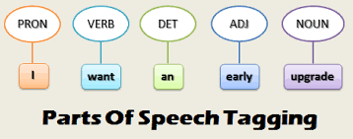
Syntactical Parsing
Part of Speech Tagging
Every word gets a tag corresponding to its part of speech
Helps AI group words together
Input | Output
Part of Speech Tagging
“This Agreement will be govern and construe in accord with law of state of California without give effect to conflict of law principle”
“N: Agreement, laws, accord, state, California, effect, conflict, laws, principles, giving V: will, be, govern, construe Det: This, and, in, with, the, of, the, of, without, to, of

Slide 11
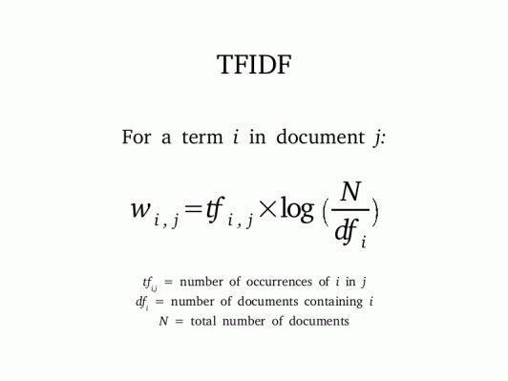
Statistical Features
Bag of Words
Keeps track of the number of times a word shows up in a sentence
TF-IDF (Term Frequency - Inverse Document Frequency)
Similar to Bag of words
Uses a formula to measure relevance
Higher TF - IDF number = more relevance to document.
More unique words.
Note: This is log base 2

Slide 12
Bag of Words example
Clause 1: Laws State New York govern matter arise relate Agreement.
Clause 2: Agreement governed internal law, not law regard conflict law, State North Carolina
Clause 3: Agreement governed construed accordance with laws State California without giving effect conflict laws principles
 | agreement | govern | law | state | matter | principles | regard | conflict | relate | etc.
C1 | 1 | 1 | 1 | 1 | 1 | 0 | 0 | 0 | 1
C2 | 1 | 1 | 1 | 1 | 0 | 0 | 1 | 1 | 0
C3 | 1 | 1 | 1 | 1 | 0 | 1 | 0 | 0 | 0

Slide 13
TF-IDF
Clause 1: Laws State New York govern matter arise relate Agreement.
Clause 2: Agreement governed internal law, not law regard conflict law, State North Carolina
Clause 3: Agreement governed construed accordance with laws State California without giving effect conflict laws principles
0.477 is a high number. In this case, the word “matter” is more relevant and unique to Clause 1.
 | agreement | govern | law | state | matter | principles | regard | conflict | relate | etc.
C1 | 0 | 0 | 0 | 0 | 0.477 | 0 | 0 | 0 | 0.477
C2 | 0 | 0 | 0 | 0 | 0 | 0 | 0.477 | 0.477 | 0
C3 | 0 | 0 | 0 | 0 | 0 | 0.477 | 0 | 0 | 0

Slide 14

Identification
Given that Clause 1 and 2 are governing law clauses, the AI would think that:
“California”, “North Carolina”, and “New York” are all locations (Entity Extraction)
The first four words have a low TF-IDF score, meaning they are shared across many documents. This means the words appear in documents like those(TF-IDF)
There is usually a word which is a location, and it is usually the answer.
So, the AI would say that Clause 3 is a governing law clause, and that the answer is “California”

Slide 15
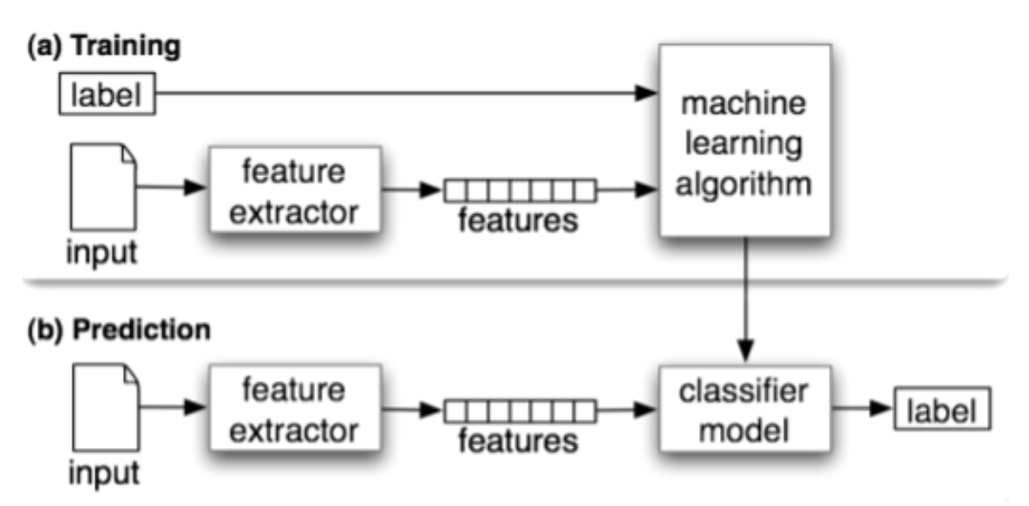
Text Classification
A technique to systematically classify a text object such as document or sentence in one of the fixed categories.
A typical natural language classifier consists of two parts: training and prediction. First the text input is processed and features are created. The machine learning models learn the features and is used for prediction against the new text.

Slide 16
Text Classification
training_corpus = [
(“This Development Agreement is entered as of this 13th Day of September 2019”, 'Effective Date’),
("Agreement made this 9th Day of March 2020", ‘Effective Date'),
(“This Agreement shall be in effect until March 13, 2021”, 'Expiration Date’),
(“The Term of this Agreement shall commence on the Commencement Date and shall terminate on June 4 2020”, 'Expiration Date')]
test_corpus = [
(“This term of this Agreement shall continue for one (1) year following the Launch Date"), --> 'Expiration Date'
("This Sponsored Research and and License Agreement is entered into on November 28, 2018"), --> 'Effective Date’
("The term of this Agreement shall commence on the Effective Date and shall expire on the last day of the Royalty Term"), --> 'Expiration Date'

